Slide 1



Spaza Shop Regulatory Management System
A Digital Framework for Fair, Transparent, and Regulated Township Business
Notes:
1

Slide 2




PROBLEM STATEMENT
-The Regulatory Gap in Township Commerce
South Africa's 150,000 spaza shops form a vital economic backbone, contributing hundreds of billions of rand annually to the informal economy. Yet this thriving sector operates without centralized oversight.
The current system creates serious challenges:
CIPC handles initial registration but provides no ongoing compliance monitoring. This gap enables unfair competition, exposes consumers to counterfeit and expired goods, and limits government visibility into township commerce.
Registration Without Monitoring
Unfair Competition
Consumer Risk
CIPC registers businesses but tracks no compliance
No transparency between native and non-native owners
Counterfeit and expired goods threaten safety
Notes:
2

Slide 3





SOLUTION
-A Digital Solution for Township Regulation
The Spaza Shop Regulatory Management System (SSRMS) provides a comprehensive digital platform that bridges the gap between business registration and daily compliance enforcement.
Centralized Regulation
Connects spaza records with ongoing monitoring
Compliance Tracking
Automated scoring and verification systems
Public Accountability
Customer feedback and transparent oversight
This system promotes fair competition, protects consumers, and empowers township entrepreneurs through technology-driven transparency.
Notes:
3

Slide 4





Vision & Strategic Objectives
Vision
To build a transparent and efficient digital regulatory ecosystem that promotes fair competition, consumer protection, and entrepreneurial empowerment across South Africa's township economies.
Digitize Registration
Streamline shop registration and verification processes through accessible digital platforms
Enforce Compliance
Monitor ownership regulations and operational standards in real-time
Enable Public Feedback
Create transparent complaint reporting and resolution mechanisms
Foster Collaboration
Strengthen partnerships among government, entrepreneurs, and consumers
Notes:
4

Slide 5


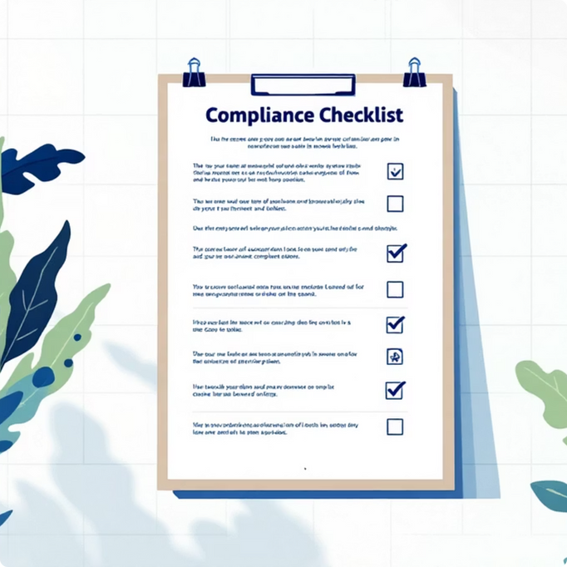
Core System Features
Registration & Verification
Role-Based Access
Automated Scoring
Streamlined digital registration with document upload and automatic validation
Customized interfaces for owners, inspectors, and customers
Real-time compliance calculation: 40% documentation, 60% inspections
Customer Portal
Ownership Control
Government Dashboard
Submit feedback and complaints with transparent tracking
Verify and enforce compliance with ownership regulations
Real-time oversight and analytics for policymakers
Notes:
5

Slide 6

Technical Architecture
Frontend Layer
Built with React.js for exceptional speed and scalability. The interface is fully responsive across mobile, tablet, and desktop devices, with real-time validation and intuitive user experience design.
Backend Infrastructure
Supabase powers secure authentication and real-time database management. Role-based permissions ensure proper data segregation, while API endpoints handle compliance scoring and document verification.
The system employs a modular, cloud-ready architecture designed for seamless integration with existing government systems. This approach ensures scalability, security, and future-proof flexibility as regulatory needs evolve.
Notes:
6

Slide 7
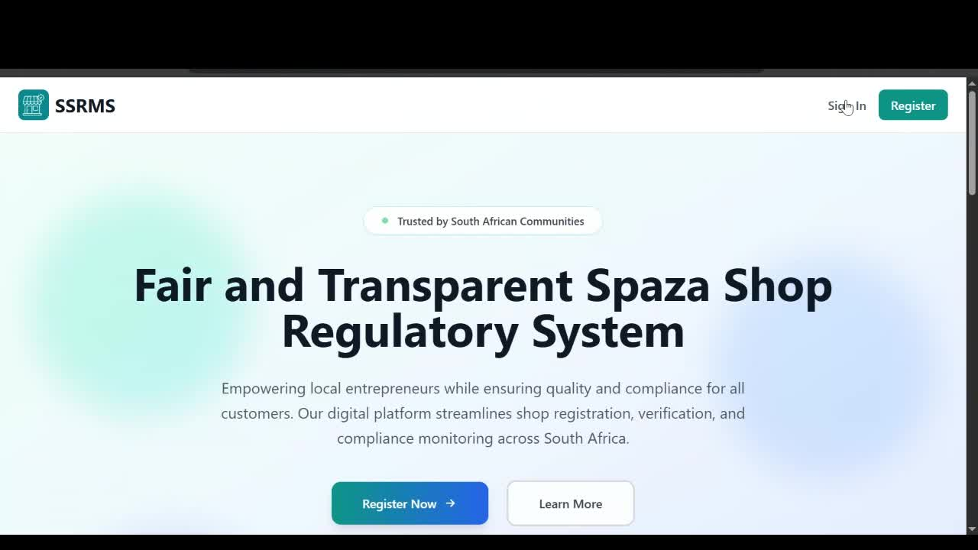
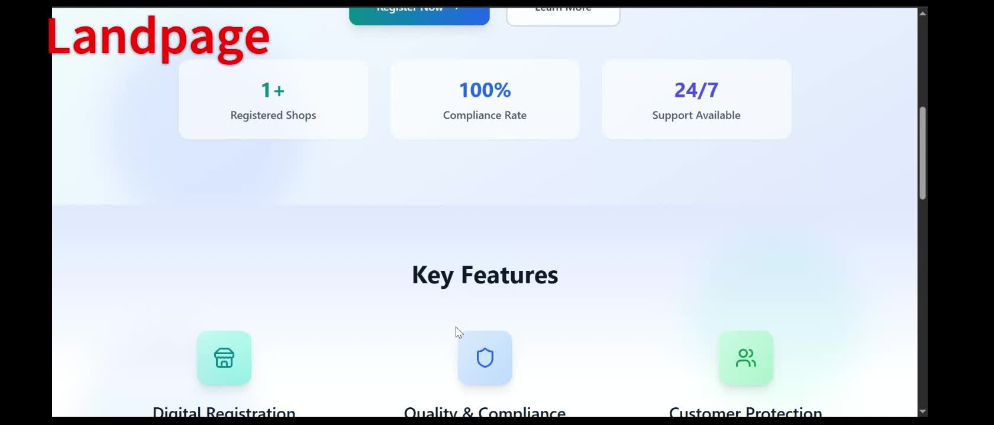
DEMO VIDEOS
Notes:
7

Slide 8
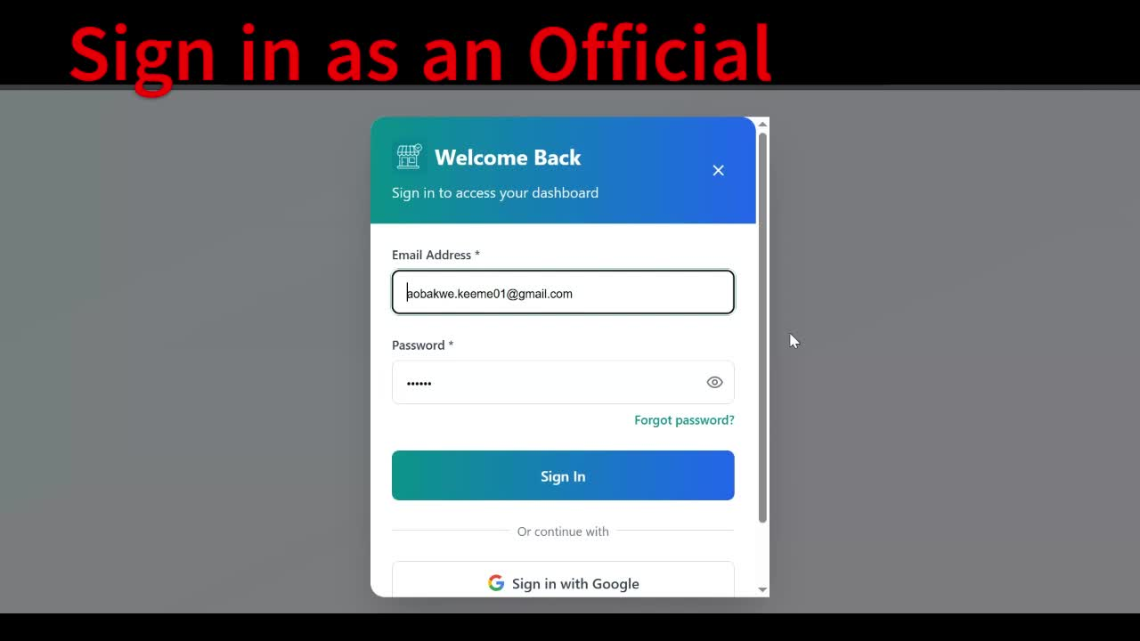
DEMO VIDEOS

Slide 9
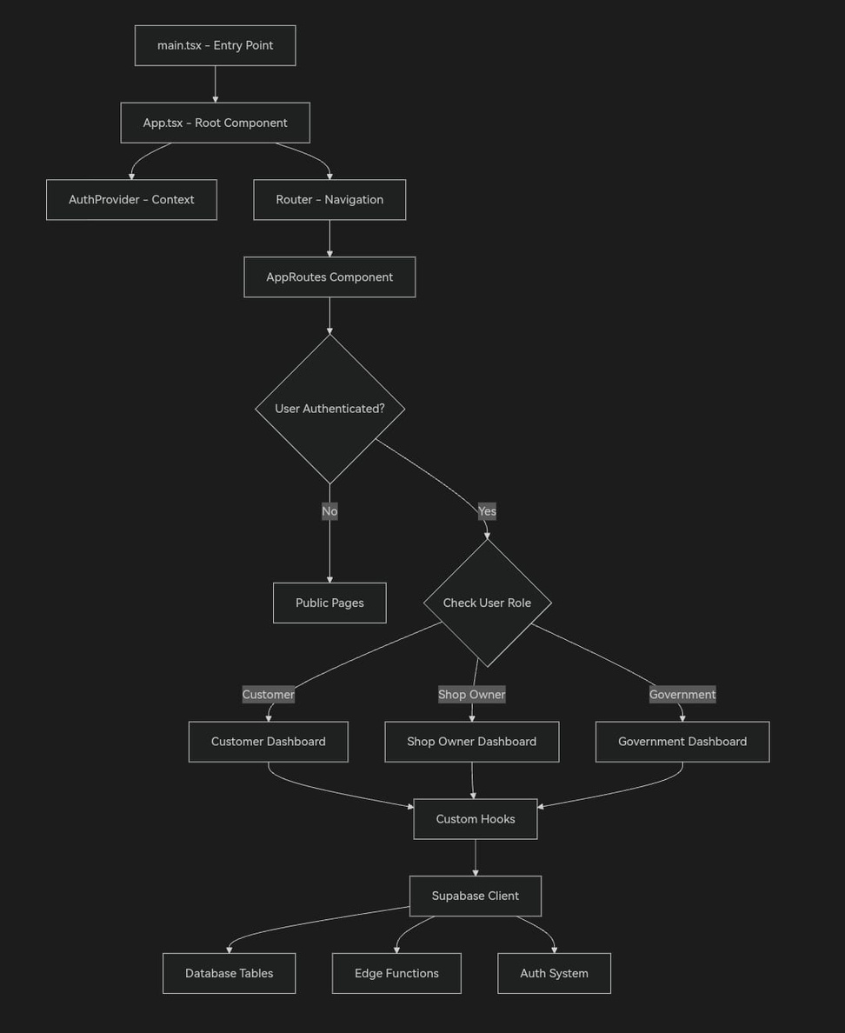
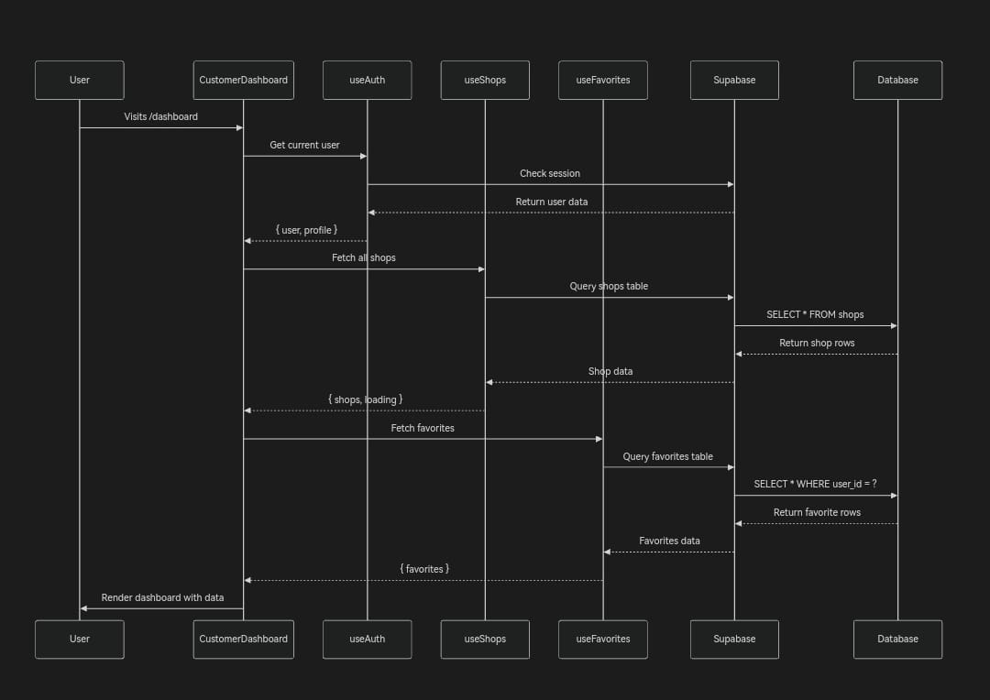
System Diagraphs
High-level architecture
Customer dashboard interaction

Slide 10





System Demonstration Overview
Four comprehensive demonstrations showcase the full regulatory lifecycle, from initial registration through ongoing compliance monitoring and public accountability.
Role-Based Access
Customized dashboards for shop owners, government inspectors, and customers with appropriate permissions and data visibility
Registration Process
Step-by-step shop registration with document upload and automatic compliance score calculation upon submission
Complaint System
Customer submission of complaints, inspector review workflow, and real-time compliance badge updates reflecting resolution
Government Monitoring
Comprehensive dashboard displaying registered shops, inspection histories, ownership statistics, and compliance trends
Notes:
8

Slide 11


Comprehensive Testing Results
Testing Methodology
Manual and functional testing conducted across Chrome browser using simulated data in Supabase. No additional installations required for validation.
Functional Validation
UI/UX Testing
Registration, login, scoring, and dashboards passed all test scenarios
Responsive across all devices with full accessibility compliance
97.2%
Performance Metrics
Security Measures
SQL injection, XSS, and authentication bypass vulnerabilities successfully patched
Load times: 0.8-1.5 seconds | Real-time sync: 95% success rate
Overall Pass Rate
70 of 72 test cases successful
Cross-Browser Support
Validated on Chrome, Edge, Firefox, and Safari with minor layout adjustments
Functional Tests
100%
All core modules validated
Notes:
9

Slide 12
Future Development Roadmap
CIPC Integration
1
Direct hyperlink to official CIPC portal for seamless business registration and verification
2
Industry News Hub
Real-time regulatory updates, policy changes, and township commerce news feed
Funding Portal
3
Curated grants and financial support programs specifically for township entrepreneurs
4
Automated Reporting
Monthly compliance summaries and analytics generated automatically for government officials
Advanced Analytics
5
Data visualization dashboard showing compliance trends, community feedback patterns, and economic impact
Strategic Partnership: Collaborating with Sinawo Siqebengu, Founder of VeriDate App by TECHNNOVATION SOLUTIONS PTY (LTD), to integrate product verification technology for combating counterfeit and expired goods.
Notes:
10

Slide 13
Implementations
The implementation of SSRMS will follow a phased, partnership-driven approach. The system will be introduced to municipal economic offices and local spaza communities for pilot use.
Engagement with the Department of Small Business Development and CIPC will ensure that the app complements national business registration systems.
Food safety and health officials will use the system to monitor hygiene standards,
While law enforcement will help ensure compliance by inspecting unregistered or unsafe shops. Through collaboration with the VeriDate app, SSRMS will expand to include product verification features, preventing counterfeit and expired goods.
Together, these partnerships will transform the informal retail sector into a regulated, safe, and trusted ecosystem.

Slide 14
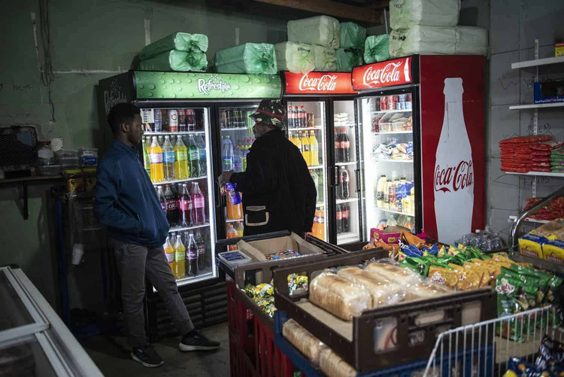
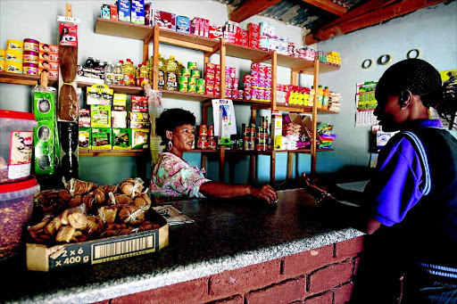
Empowering Township Entrepreneurs Through Innovation
Production Ready
Scalable Impact
Secure, fast, and user-friendly system validated through comprehensive testing
Real solutions for regulating 150,000+ township businesses across South Africa
Social Innovation
Bridging digital gaps while ensuring fairness, transparency, and consumer safety
"Together, we bridge the digital divide in informal business governance—empowering entrepreneurs while ensuring compliance and consumer safety."
WSU -THE GENESIS | October 2025
This project embodies innovation, social impact, and sustainable development for South Africa's township economies.
Notes:
11

Slide 15

THANK YOU !!

